Slide 1
Local Group Policy
Using PowerShell

Slide 2
INTRODUCTION
There is no real implict way to set local policies in Powershell. To do this, we need to do some workarounds.

Slide 3
The SECEDIT Command
What is it and how do we use it?

Slide 4
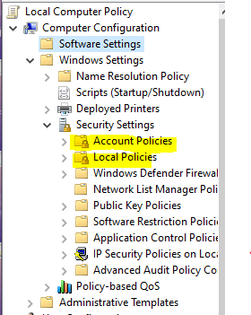
What is Secedit?
Secedit allows a user to find and change local policies on their computer.
This requires administrative privileges and are limited only to the “Computer Configurations” of Group Policy as picture to the
right.

Slide 5
Secedit
secedit /configure
secedit /analyze
secedit /export
secedit /import
Changes computer settings based on a config file
Analyzes current computer settings
Exports current computer settings to a config file
Imports current computer settings from a config file

Slide 6
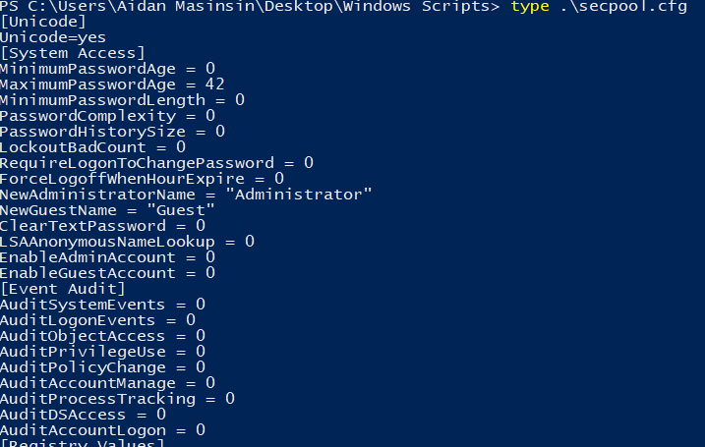
The Method:
Create a Configuration File:
secedit /export /cfg c:\secpol.cfg
This creates a Configuration File that we can manipulate and change
The Configuration File will show all of the policies we can configure on our computer.
We can look up specifics on Microsoft Docs Page.

Slide 7
The Method:
Edit a Configuration File:
(Get-Content C:\secpool.cfg)replace("PasswordComplexity = 1", "PasswordComplexity = 0") | Out-File C:\secpol.cfg
This replaces the configuration file with a setting that we want to change it with.
There are other ways of changing the configuration file, this is simply only one method.

Slide 8
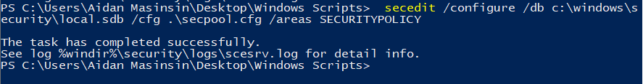
The Method:
Set the Configurations:
secedit /configure /db C:\Windows\Security\local.sdb /cfg c:\secpol.cfg /areas SECURITYPOLICY
This overwrites the existing policies with the policies from our configuration file, secpol.cfg

Slide 9
THANKS

Slide 10


